Slide 1
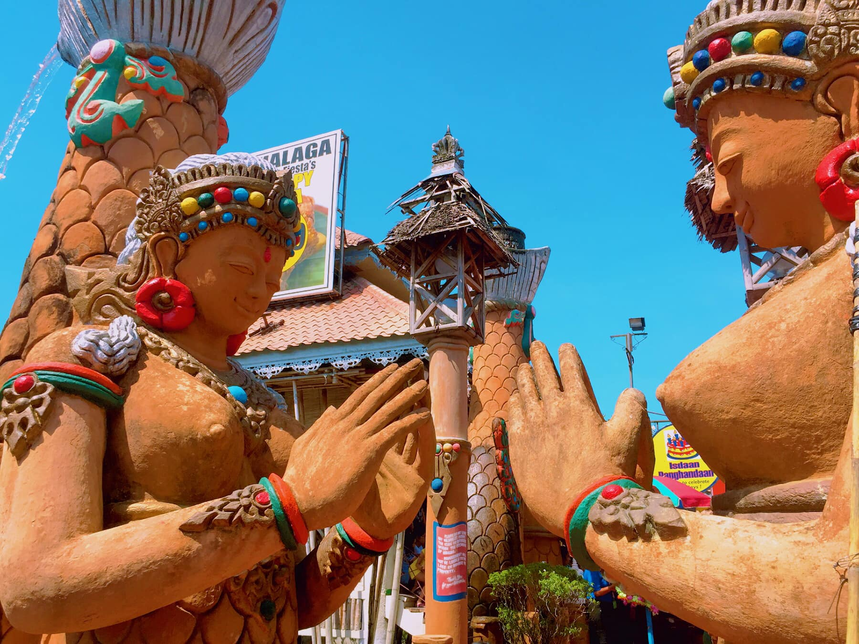

Web Based Reservation and Scheduling System in Isdaan Floating Restaurant in Calauan, Laguna
CMSC 311
HALLIG, SIERA
MACASAET, KATE ASHLEY
PLATA, GIANNAH FAITH
TORRES, TRACY
BSCS 3B

Slide 2

Background and Initial Scope

Slide 3

Background and Initial Scope
The Isdaan Floating Restaurant in Calauan, Laguna used to rely on a manual walk-in reservation system, which often caused long lines and scheduling problems. These issues became harder to manage during and after the pandemic. To help improve their process, a web-based reservation and scheduling system is created. This system lets customers easily check available slots, book or cancel reservations, and message the admin if needed. For the staff, it helps them organize bookings, manage daily schedules, and avoid no-shows. The main goal of updating this system was to modernize how the restaurant handles reservations and make things easier for both customers and staff.

Slide 4
Key Enhancements

Slide 5

Key Enhancements
COSTUMER PAGE
Costumer Registration in web-based application
Can Log-in and do reservations once you have an account
Real-time registration
Can view the location of restaurant by googles maps
Can direct to their FB page using the link
Can view the cottages available with capacity and rates
Attractive UI design of the costumer page

Slide 6
Key Enhancements
COSTUMER PAGE
Registration details with gmail account
Only valid and one gmail can use
After registration, inside the account can only view and book a reservation
Real-time reservation with date and time
Can make multiple reservation
Can view the details of reservation
Can cancel the reservation
Can make special request during reservation

Slide 7
Key Enhancements
ADMIN PAGE
Default admin account (username and password)
DASHBOARD
- Implemented number of users, reservations, confirms and pending reservations
- Real-time lists of total reservations scheduled
- Can view the details of costumer's reservations

Slide 8
Key Enhancements
ADMIN PAGE
Default admin account (username and password)
APPROVED
- Organized detail lists of confirmed, Pending, and Cancelled registration
- With number of guests, status, and cottage type

Slide 9
Key Enhancements
ADMIN PAGE
Default admin account (username and password)
USERS
- Details of registered costumer
- Can view how many reservations that the user made
- Real-time registration

Slide 10
Key Enhancements
ADMIN PAGE
Default admin account (username and password)
SETTINGS
- Implemented cottage settings and admin account
- Can edit the value or rates of the cottage
- Can update admin username and password

Slide 11
Screenshots of the System

Slide 12
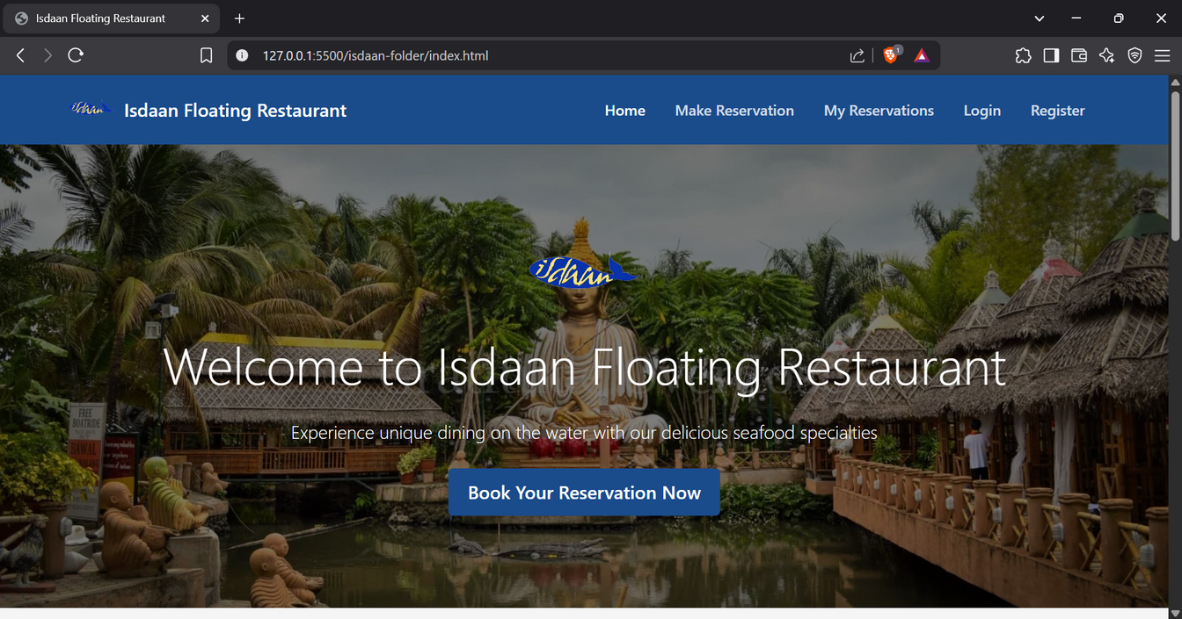
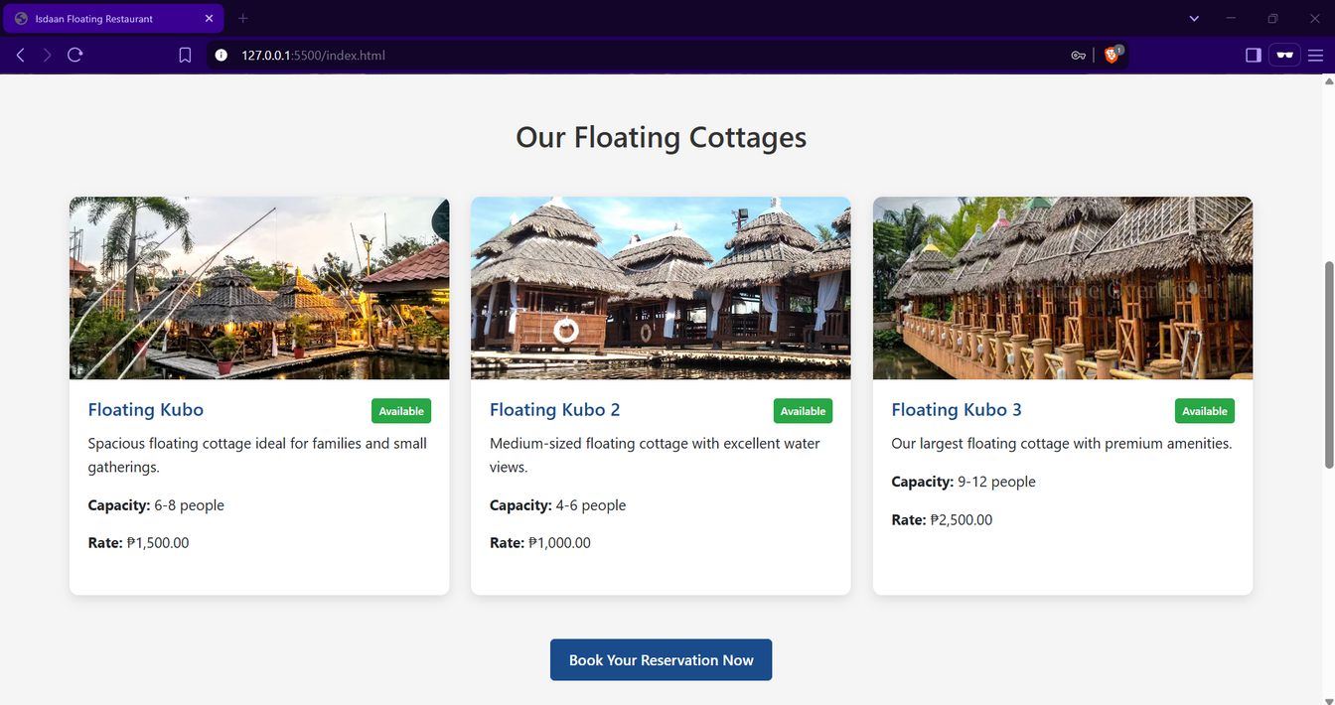
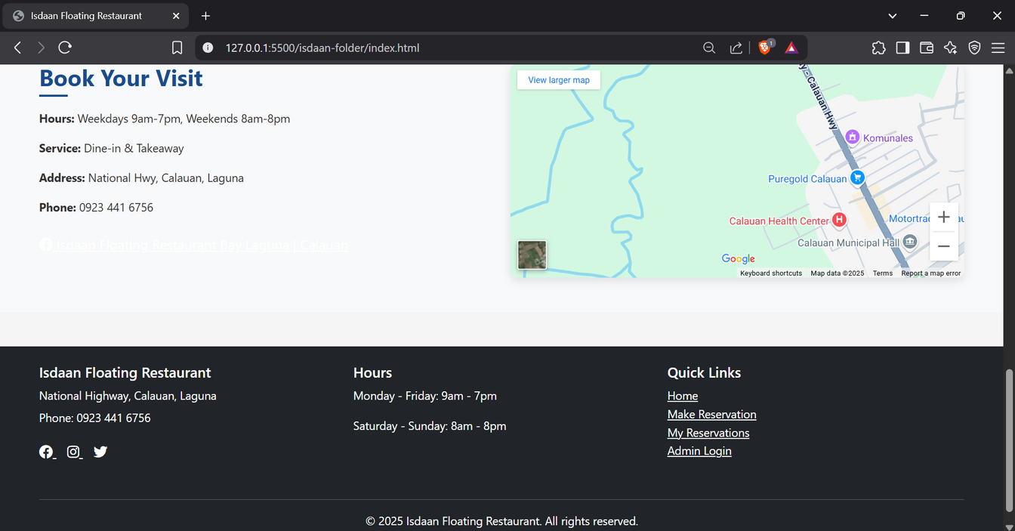
Main Interface for Guest

Slide 13
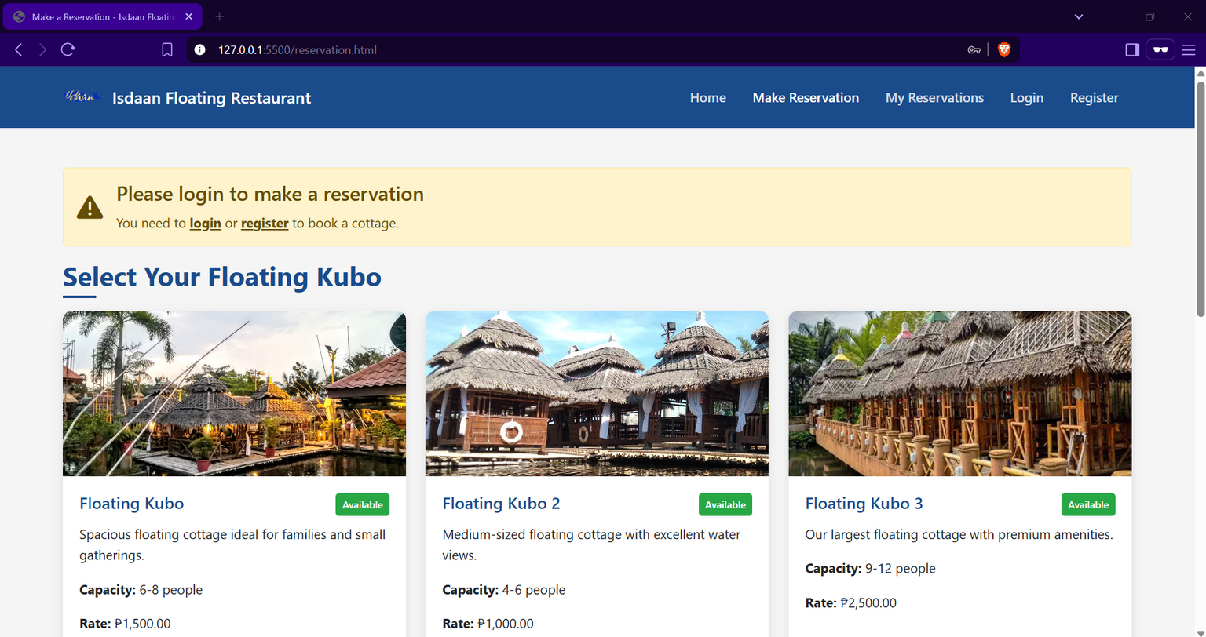
Make Reservation Page

Slide 14
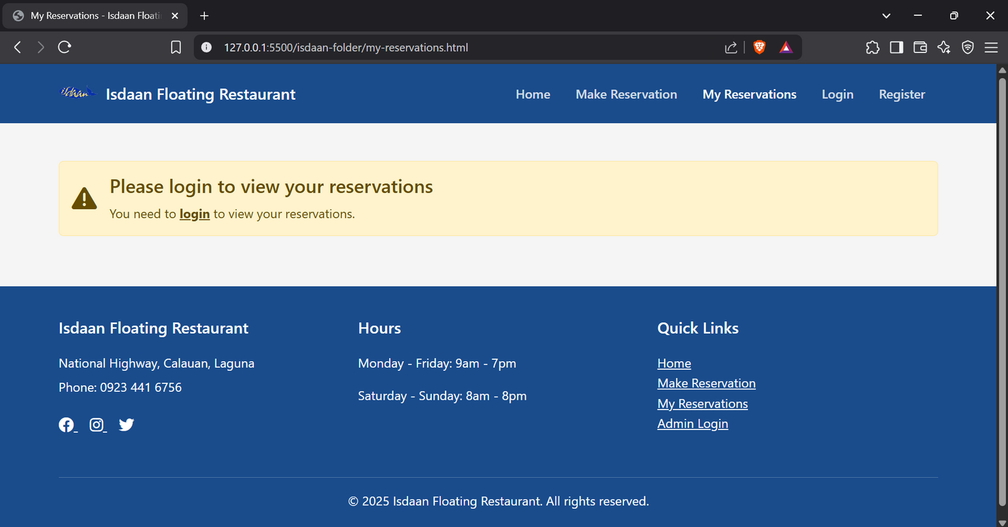
View Reservation Page

Slide 15
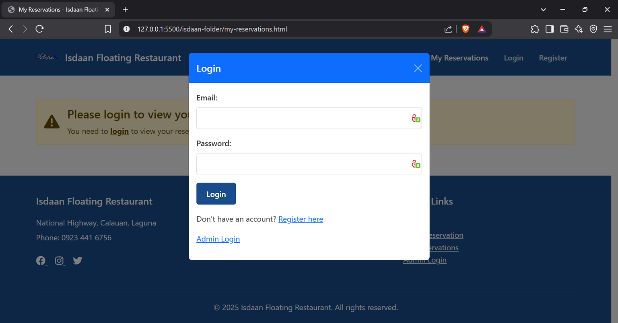
Login Page for Customer

Slide 16
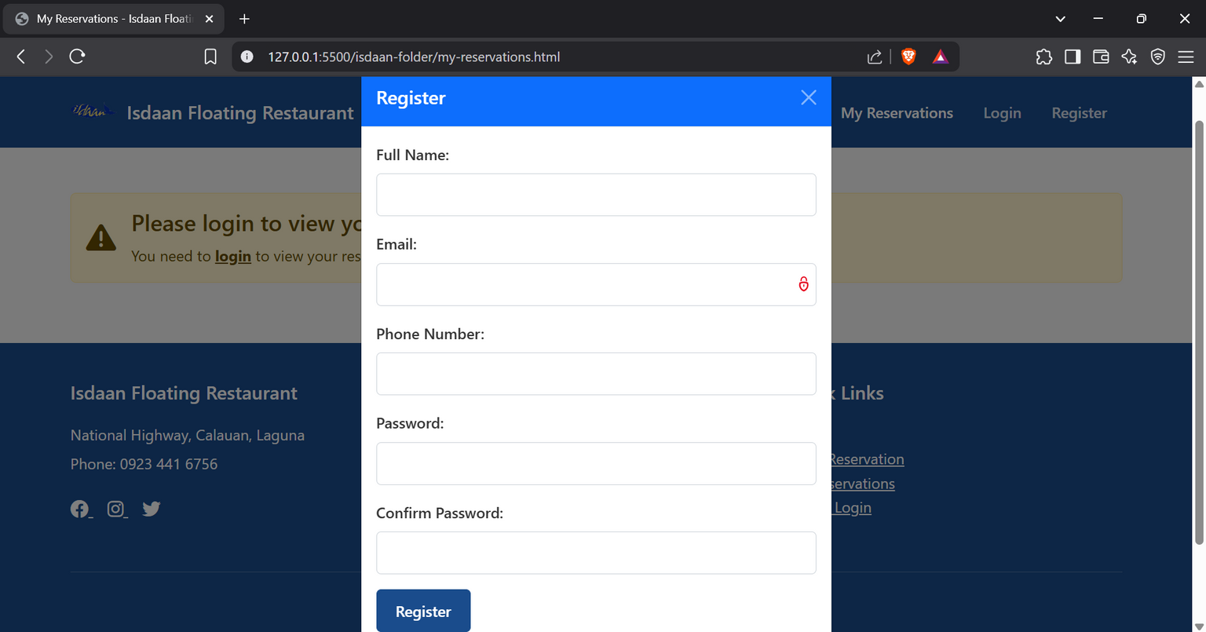
Register Page for New Customer

Slide 17
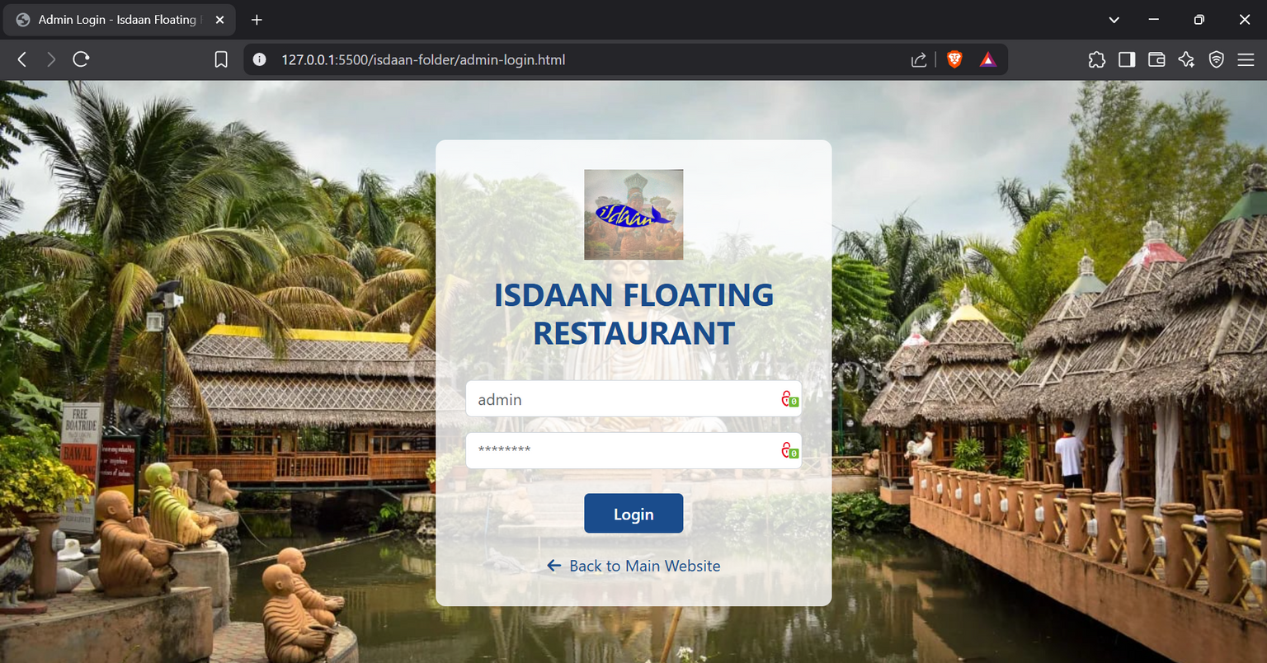
Admin Login Page

Slide 18
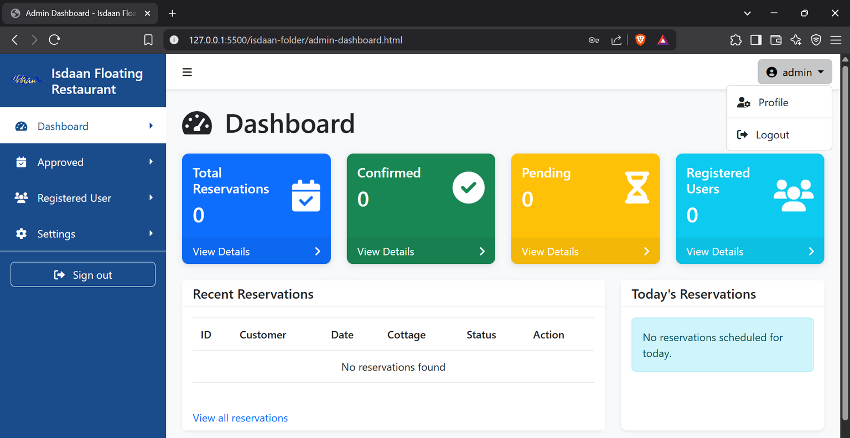
Admin Dashboard

Slide 19
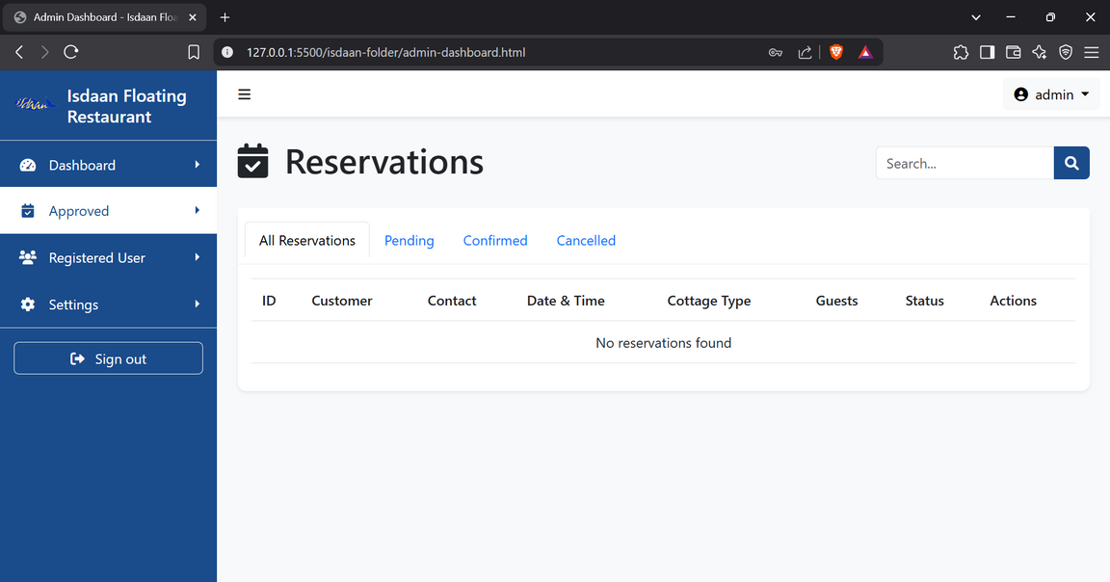
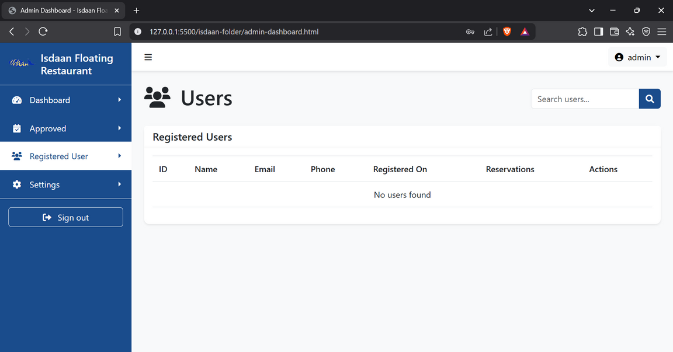
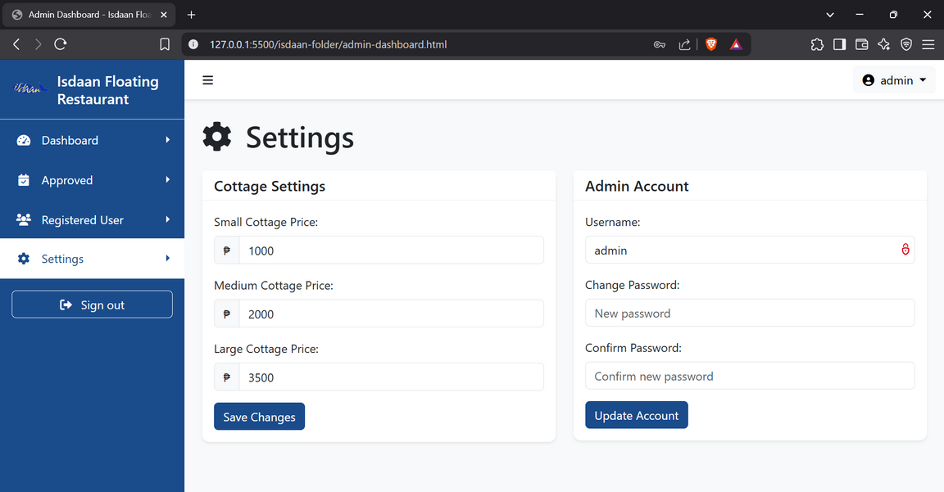
Sidebar Tabs

Slide 20
Lessons Learned

Slide 21
Conclusion
One of the biggest things we learned was the importance of user feedback. By listening to what customers and staff needed, we were able to make changes that really improved how the system worked. We also saw how limiting a manual system can be—long lines and double bookings were common before, and switching to an online system made everything more organized and easier to manage. Another lesson was that simple design is better. Users appreciated a clean layout and easy navigation more than advanced features. Lastly, we realized that updating a system is an ongoing process. Just because it works now doesn’t mean it can’t be better later, so it’s important to keep improving based on new problems and user suggestions.

Slide 22
Thank
You

